Slide 1
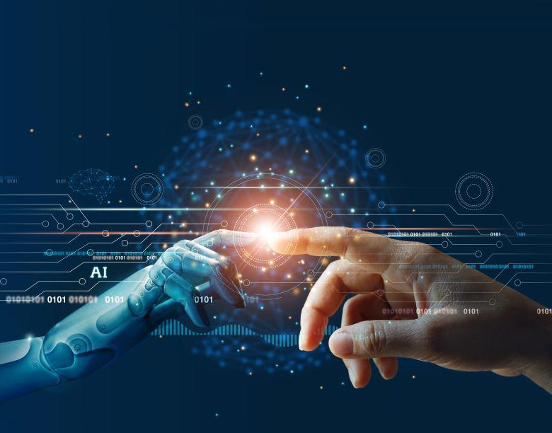
Artificial Intelligence & Data Science
For INNOIATION
By Sandesh Gajendra Pol

Slide 2

Point to be discussed
What is Artificial Intelligence
Major Artificial Intelligence approach
What is Data Science
Applications
Conclusion

Slide 3
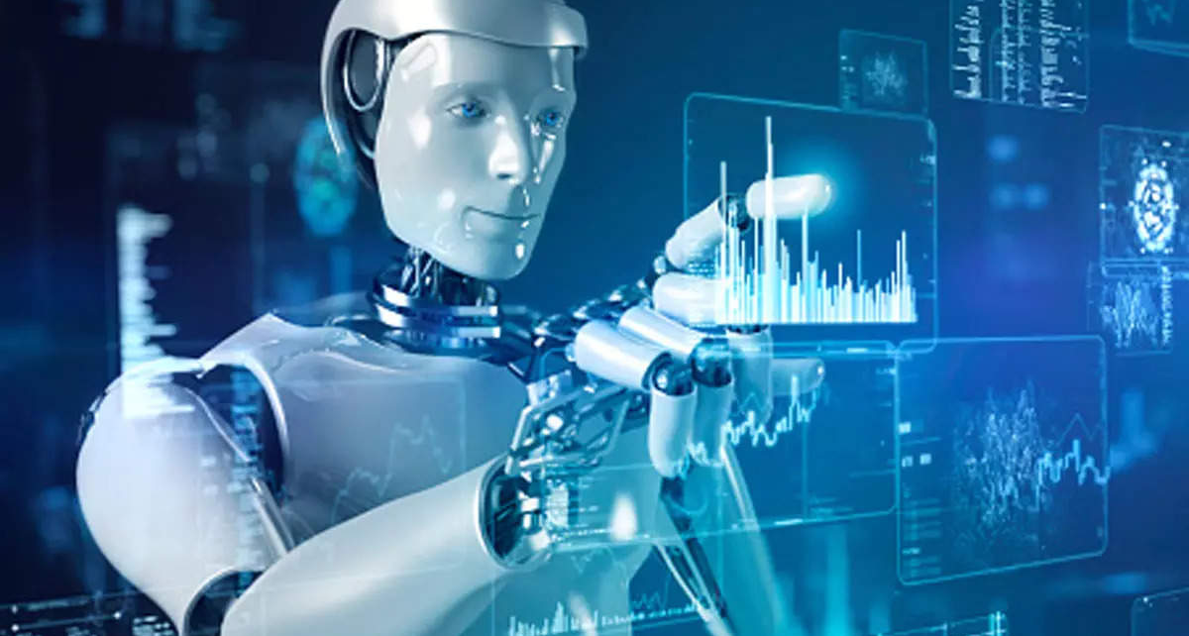
What is Artificial Intelligence
AI is the ability of the machines or computer program To carry out tasks that requires human beings to use their intelligence
Artificial intelligence is the ability of a computer program or a machine to think and learn.
The teams Machine Learning and Deep Learning is sub set of Artificial Intelligence

Slide 4

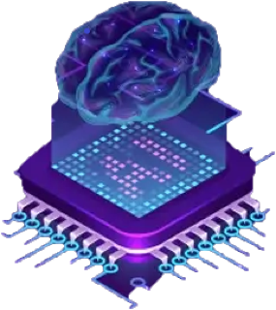
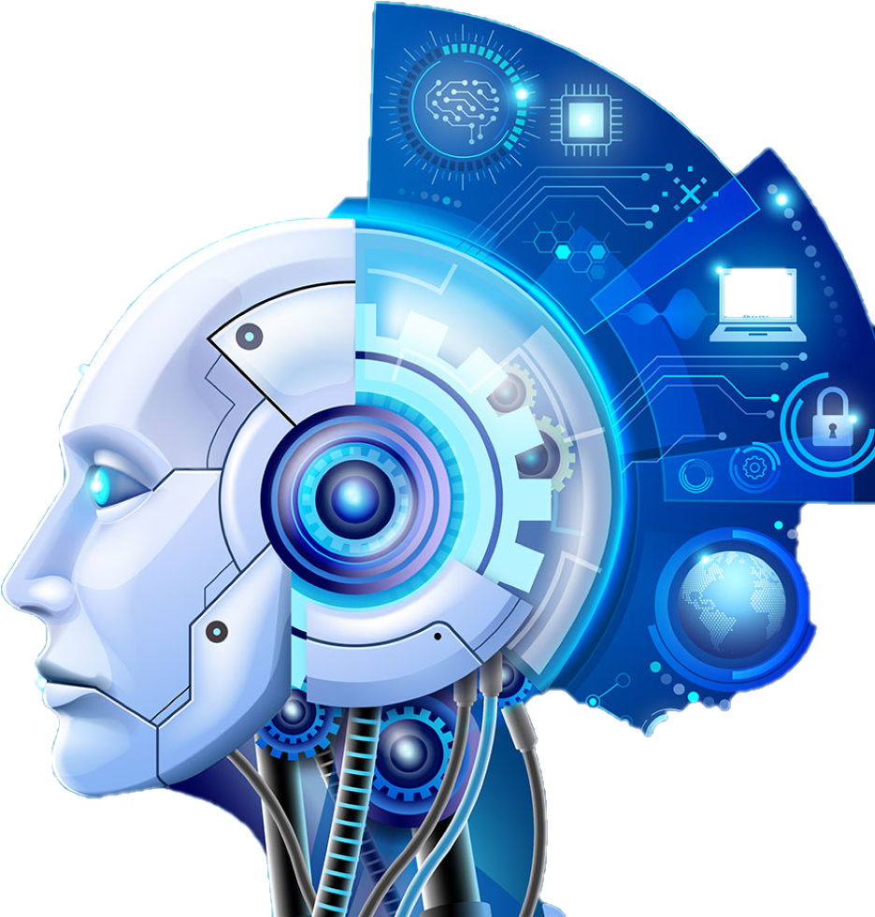
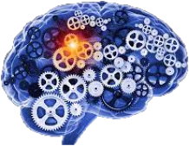
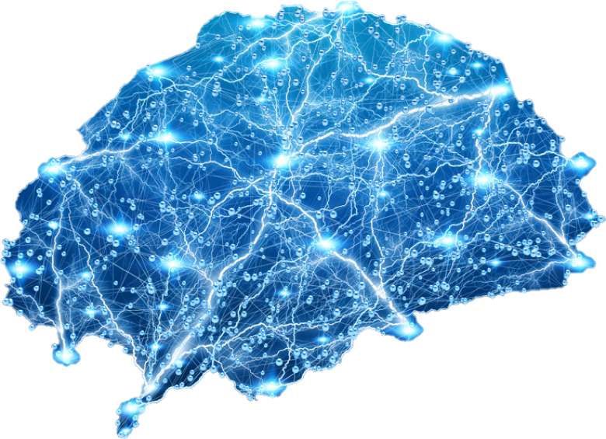
Major Artificial Intelligence approach
Rules and logic
base approach
Machine learning based approach
Neural Networks
base approach
Hybrid system
base approach

Slide 5
Hybrid system
base approach
Machine learning based approach
Major Artificial Intelligence approach
Neural Networks base approach
Rules and logic base approach
D
C
A hybrid system in AI refers to a combination of multiple artificial intelligence techniques or approaches that are used together to solve a particular problem. The base approach of a hybrid system in AI refers to the primary technique or method that is used as the foundation or starting point for the system. This base approach is then combined with one or more additional AI techniques to create a more powerful and effective solution
Neural networks are a type of machine learning algorithm that are inspired by the structure of the human brain. They are made up of interconnected nodes or neurons that work together to process and analyze data. Neural networks are particularly good at identifying patterns in complex data sets.
B
In this approach, AI systems are programmed with a set of rules and conditions that dictate how they should behave in different situations. These rules are based on human expertise and knowledge, and the system uses them to make decisions and perform tasks
Machine learning is an AI approach that involves training algorithms to learn from data. The system is fed large amounts of data and uses statistical methods to identify patterns and relationships. The system can then use this knowledge to make predictions and decisions
A

Slide 6
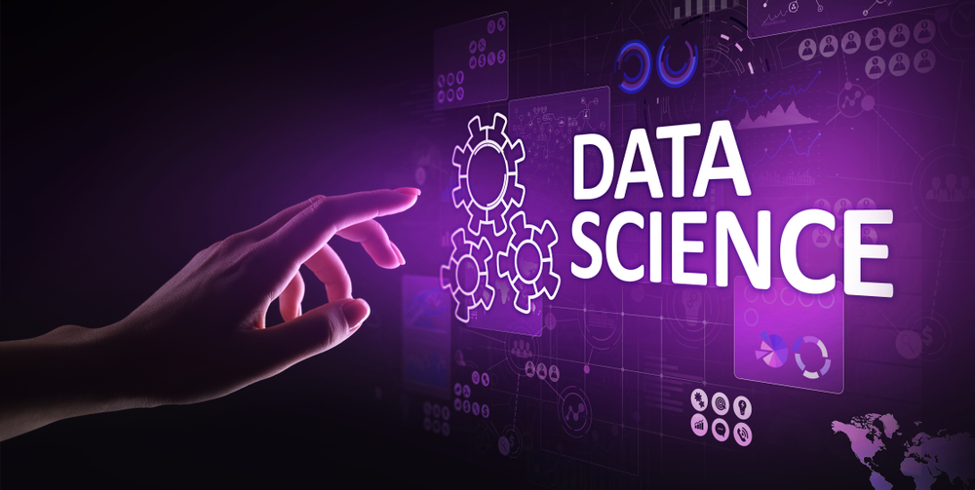
What is Data Science
Data science is the field of study that combines statistical analysis, machine learning, and programming to extract insights and knowledge from data

Slide 7
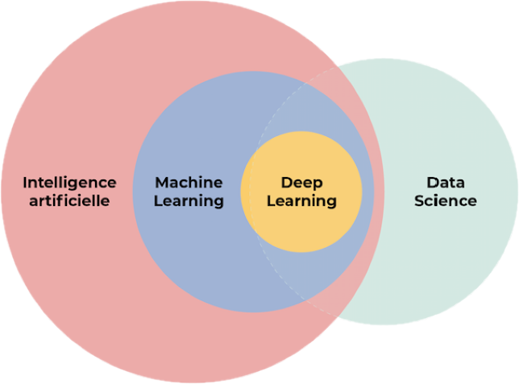
Relation between Artificial Intelligence & Data Science

Slide 8
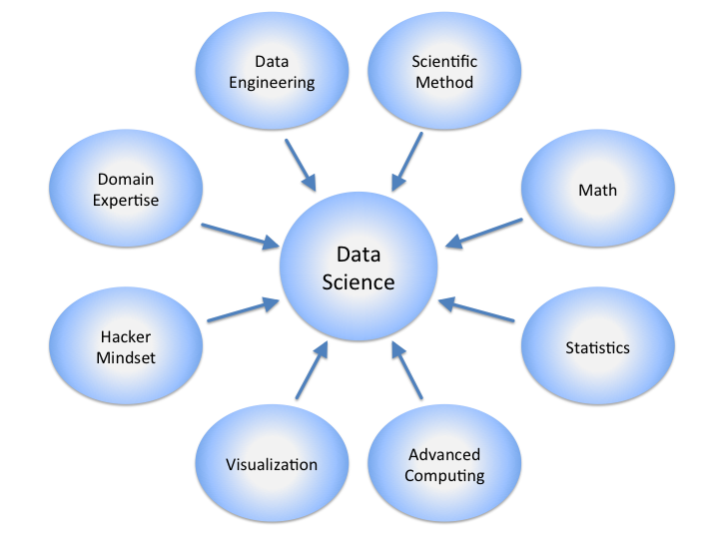
Data Science

Slide 9
Data preprocessing
Working of Data Science
Data modeling
Data collection
Exploratory data analysis
Step 4
Step 3
Once the data is cleaned and preprocessed, it can be visualized and explored to identify patterns, trends, and relationships. This may involve using statistical tools, data visualization libraries, or machine learning algorithms.
The next step involves cleaning and preprocessing the data to ensure that it is suitable for analysis. This may involve tasks such as removing duplicate or irrelevant data, filling in missing values, and transforming the data into a standardized format.
Once the data has been explored, predictive models or other statistical algorithms are built and tested to help answer the question or solve the problem
The first step in data science is to gather the necessary data from various sources such as databases, APIs, or websites. The data may be in different formats, such as structured or unstructured, and may need to be cleaned and preprocessed before analysis.
Step 2
Step 1

Slide 10
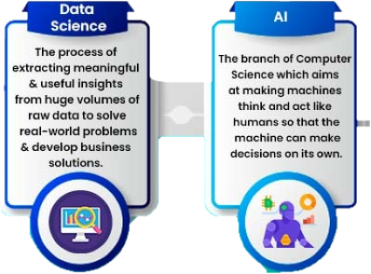
Difference between AI and Data science

Slide 11
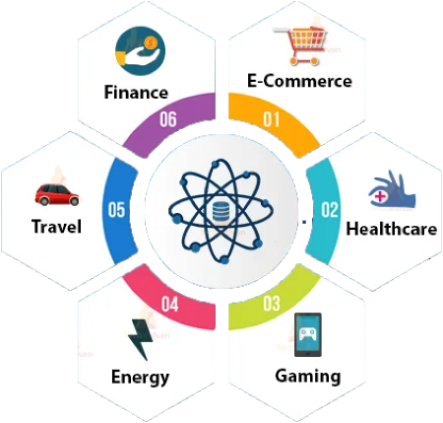
Application of Data Science

Slide 12

Case study on AI and Data science
Google search engines and shopping ads

Slide 13
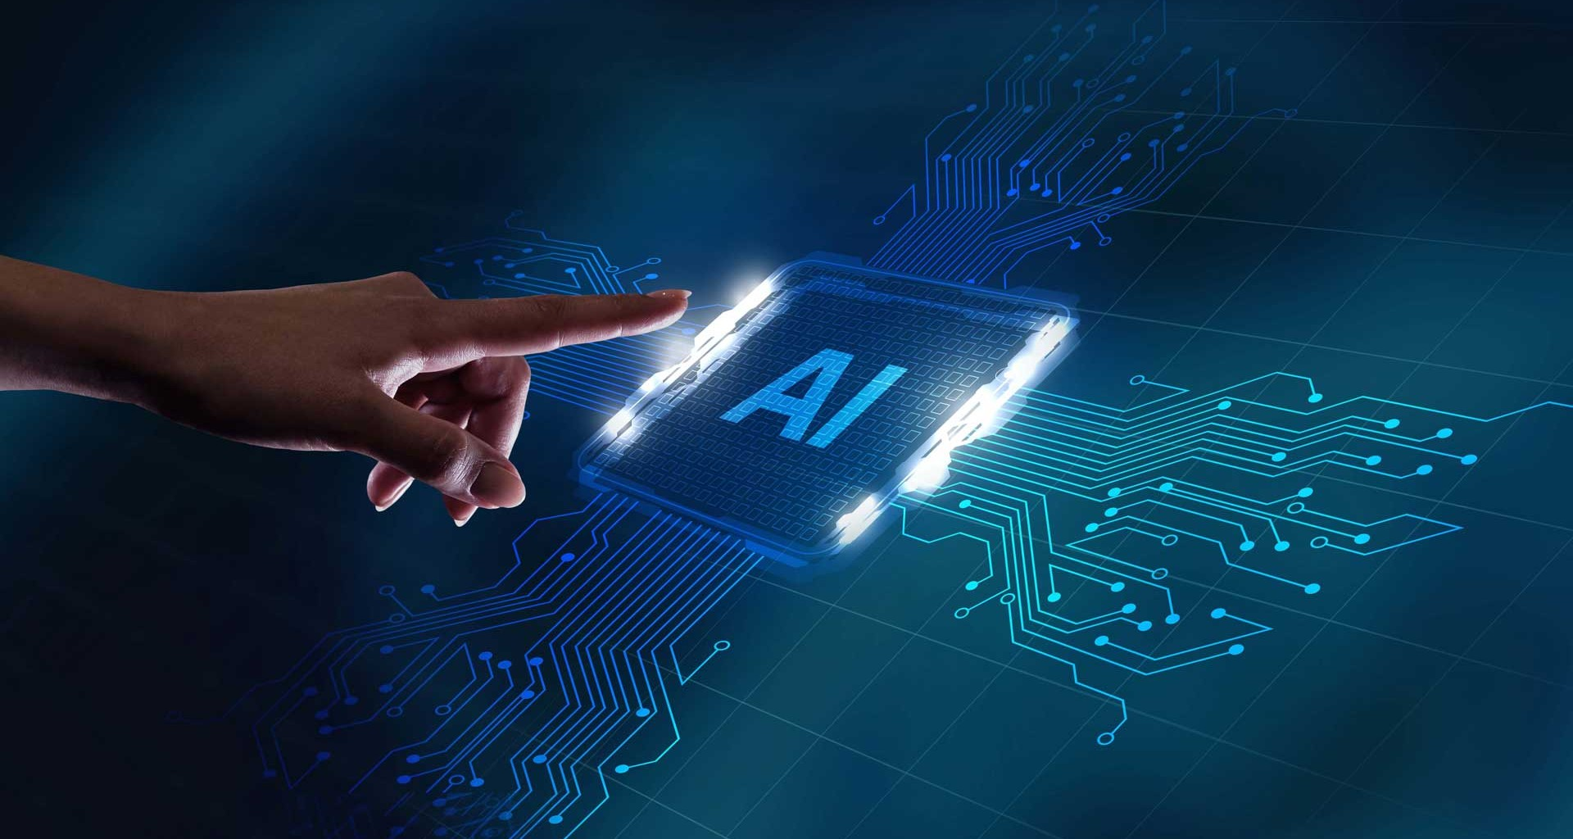
Conclusion
Data science is a rapidly growing field that involves using statistical and computational techniques
Data science can be used in a wide range of industries and applications, including business, healthcare, finance, marketing, and more.
There are many incidence that scientist reported that AI can destroy humanity

Slide 14

THANK YOU!
Sandesh Gajendra Pol
Phone:
9067248106
Email:
sandeshpol268@gmail.com

